Slide 1
CS 540
Java Message Service(JMS) Open MQ
Luis C.
Sam A.
Avenir F.
Kaan O.

Slide 2
What Is JMS
•Java Message Service
•Is a Java Messaging Oriented Middleware(MOM) API
•API = Application Program Interface
•It is used for sending messages between 2 or more clients

Slide 3
JMS Cont.
•JMS is part of the Java Platform Enterprise Edition (JavaEE)
•JMS allows applications to Create, Receive, Send and read messages
•Messaging is loosely coupled, reliable and asynchronous
•Loosely coupled: requires little or no knowledge of separate components

Slide 4
History Of JMS
•JMS 1.0.b(June 25,2001)
•JMS 1.1 (April 12, 2002)
•JMS 2.0 (May 21,2013)
•JMS 2.0 is currently maintained by Java Community Process

Slide 5
JMS Elements
•JMS Provider
•JMS Client
•JMS Producer/Publisher
•JMS Consumer/Subscriber

Slide 6
JMS Elements
•JMS Message
•JMS Queue
•JMS Topic

Slide 7
JMS Provider
•JMS Provider: Is an implementation of the JMS interface for a Message Oriented Middleware(MOM).
• Providers are implemented as a Java JMS implementation or an adapter to a non-java MOM

Slide 8
JMS Provider Cont.
• JMS provider manages the sessions, queues and topics
Apache Active MQ
Oracle Open MQ
Open JMS
etc...

Slide 9
JMS Clients
•JMS Client: An application or process that produces and/or receives messages.
•There are two types of Clients

Slide 10
JMS Clients Cont.
•JMS Producer/Publisher: A JMS client that creates and sends messages.
•JMS Consumer/subscriber: A JMS client that receives messages.

Slide 11
JMS Message
•JMS Message: An object that contains the data being transferred between JMS clients.
• Consists of Header, Properties and Payload/Body

Slide 12
JMS Message Cont
•Header - All messages support the same set of header fields. Header fields contain values used by both clients and providers to identify and route messages.

Slide 13
JMS Message Cont
•Properties - Each message contains a built-in facility for supporting application-defined property values.
•Properties provide an efficient mechanism for supporting application-defined message filtering.

Slide 14
JMS Message Cont
•Payload/Body - The JMS API defines several types of message body, which cover the majority of messaging styles currently in use.

Slide 15
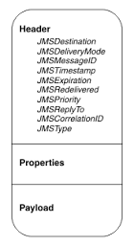
JMS Message Cont

Slide 16
JMS Queue
•JMS Queue: A staging area that contains messages that have been sent and are waiting to be read (by only one consumer).
•Messages don't have to be received in the order in which they were sent

Slide 17
JMS Queue Cont.
•Only guarantees that each message is processed only once

Slide 18
JMS Topic
•JMS Topic: A distribution mechanism for publishing messages that are delivered to multiple subscribers.

Slide 19
JMS Models
•The JMS API supports two models:
•Point-to-point
•Publish and Subscribes

Slide 20
Point To Point Model
•Messages are routed to an individual consumer which maintains a queue of "incoming" messages
•This messaging type is built on the concept of message queues, senders, and receivers

Slide 21
Point To Point Model Cont
•Each message is addressed to a specific queue
•Each message is guaranteed to be delivered, and consumed by one consumer.
•Queues retain all messages sent to them until the messages are consumed or until the messages expire

Slide 22
Point to Point Cont.
•If no consumers are registered to consume the messages, the queue holds them until a consumer registers to consume them

Slide 23
Publish & Subscribe Model
•Publishing messages to a particular message topic
•Subscribers may register interest in receiving messages on a particular message topic
•Neither the publisher nor the subscriber knows about each other

Slide 24
Publish & Subscribe Cont.
•A good analogy for this is an anonymous bulletin board
•Zero or more consumers will receive the message.
•The publisher has to create a message topic for clients to subscribe.

Slide 25
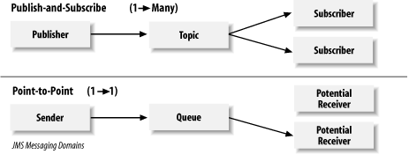
Comparing Both Models

Slide 26
Open Message Queue
OpenMQ or Open MQ is an open source message-oriented middleware project by Oracle (formerly Sun Microsystems) that implements the Java Message Service 2.0 API (JMS). It is the default JMS provider integrated into GlassFish.

Slide 27
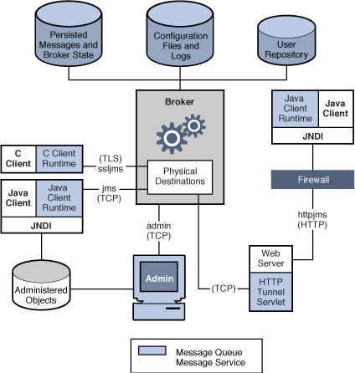

Slide 28
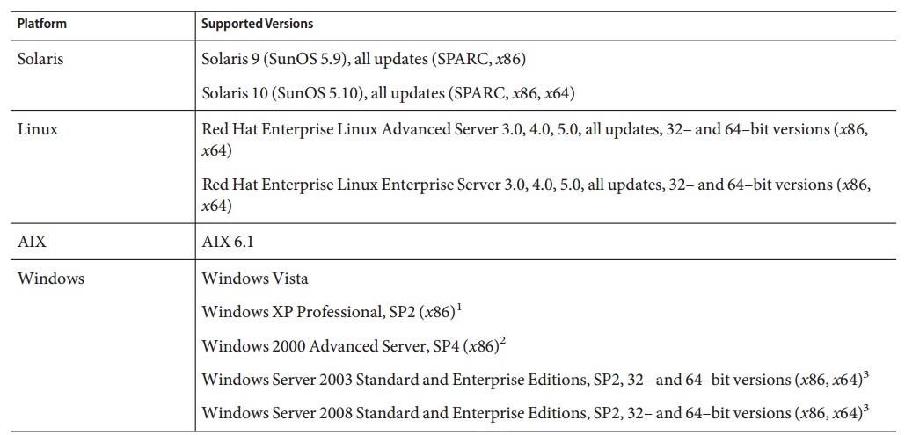
Installation Platforms
1. JDK 1.6.0_13 or higher 2. Ant 1.7.1 or higher

Slide 29
Installation Process
You can run the Open MQ Installer in either of two modes:
In GUI (graphical user interface) mode, the Installer presents a series of graphical screens with which you interact using mouse clicks and keyboard text entry.
In silent mode, the Installer operates from a predefined answer filerepresenting your responses to the GUI screens. This allows you to script the installation process in advance and then perform it in batch mode without actually displaying the GUI screens and responding to them interactively.

Slide 30
Installing in GUI Mode
Create a temporary directory. From your system’s command line, enter the command
$ mkdir tempDir
where tempDir is any name you choose for your temporary directory

Slide 31
Download the Open MQ Installer to the temporary directory.
https://mq.java.net/downloads.html#source

Slide 32
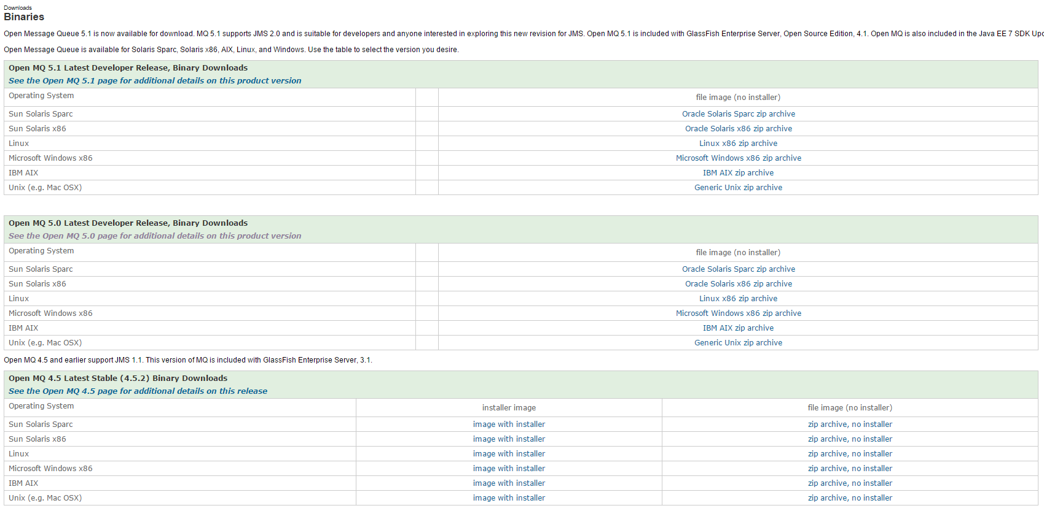

Slide 33
Go to the temporary directory
Enter the following command:
$ cd tempDir
where tempDiris the temporary directory to which you downloaded the Installer in step 3.

Slide 34
Decompress the Installer archive.
Enter the following command:
$ unzip openmqversion-installer-OS_platform [-build#].zip
This creates a subdirectory named mq4_3-installer containing the files needed for Open MQ 4.3 installation

Slide 35
Switch to the Installer subdirectory.
Enter the following command:
$ cd mq4_3-installer

Slide 36
Start the Installer.
Enter the following command:
$ installer
Note – The installer command requires that a JDK or JRE be specified, either by using the JAVA_HOME environment variable or by using the -j option on the command line, as follows:
$ installer -j JDK/JRE-path
where JDK/JRE-path is the path of the specified JDK or JRE. The Installer’s Welcome screen appears.

Slide 37
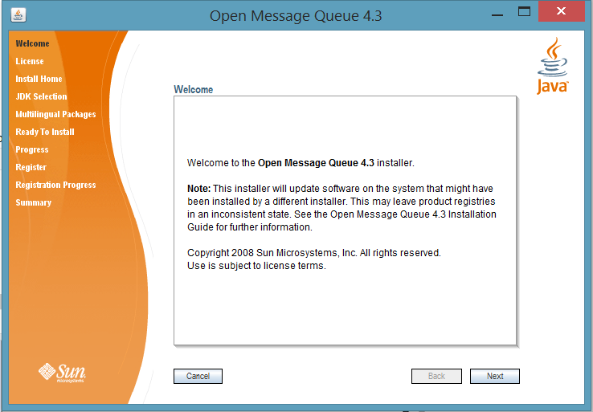

Slide 38
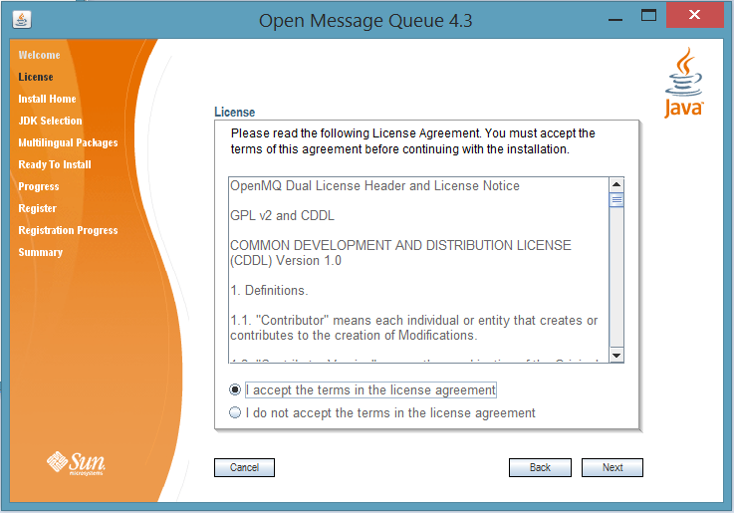

Slide 39
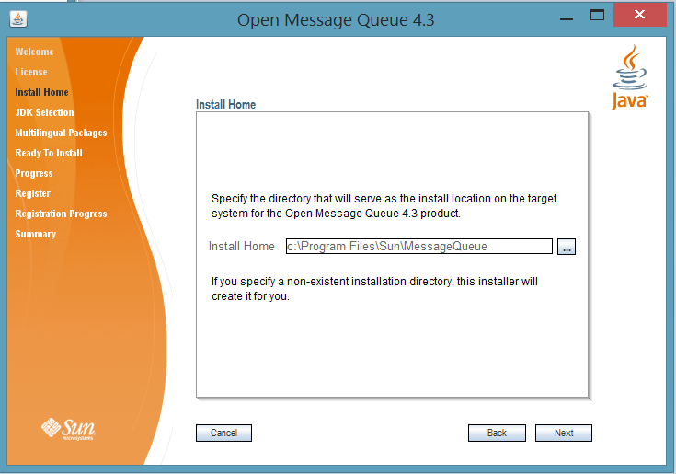

Slide 40
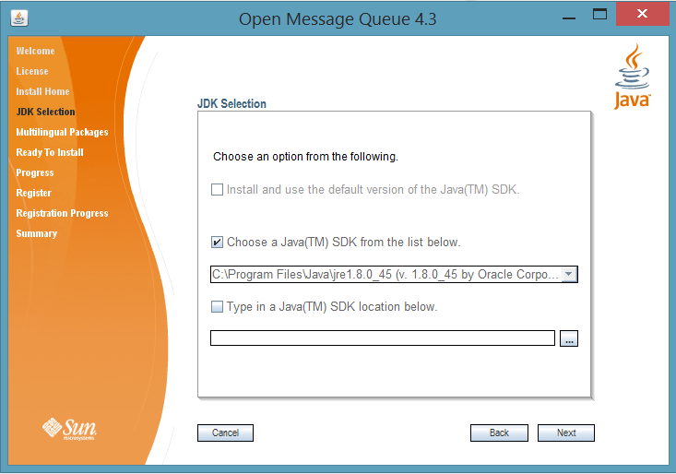

Slide 41
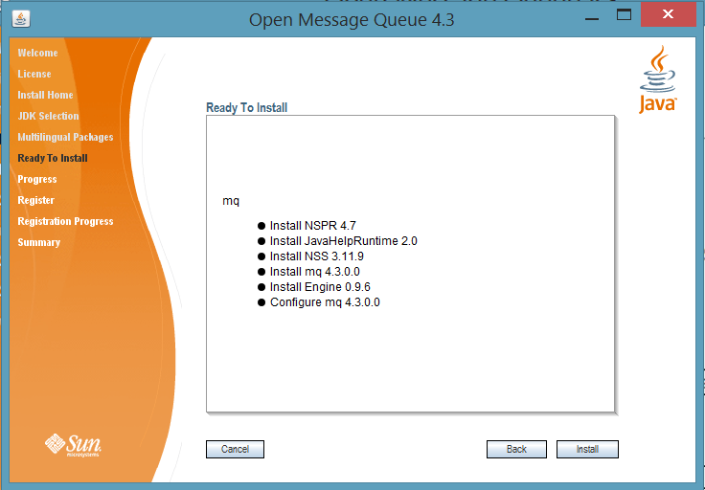

Slide 42
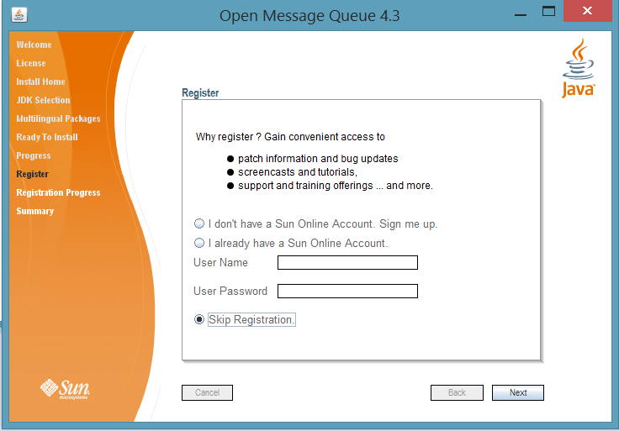

Slide 43
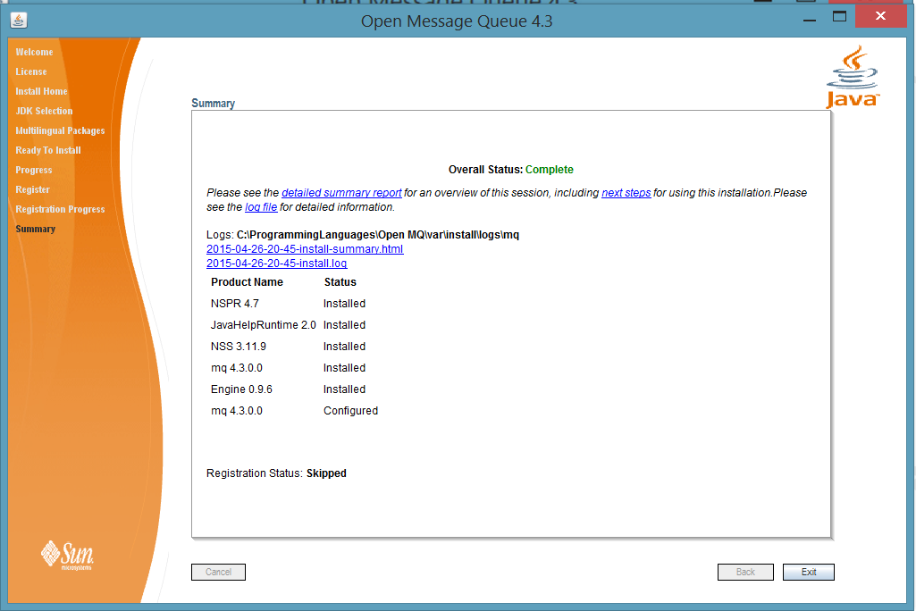

Slide 44
Open MQ installation is now complete.
Tip – After installation is complete, you can check that the expected version of Open MQ has been installed by navigating to the Open MQ /bin directory and executing the command
$ imqbrokerd -version
The output from this command identifies the versions of Open MQ and the Java SDK that are installed on your system.

Slide 45
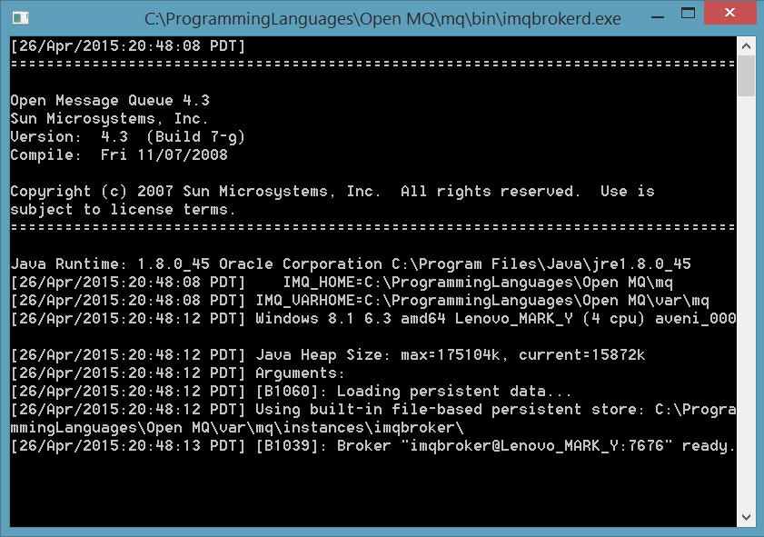
C:\ProgrammingLanguages\OpenMQ\mq\bin
imqbrokerd.exe

Slide 46
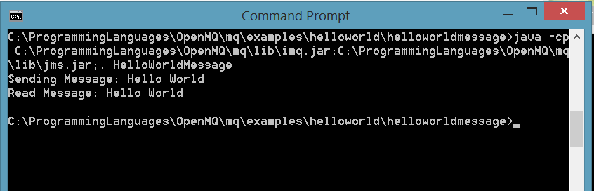
C:\ProgrammingLanguages\OpenMQ\mq\lib
imq.jar and jms.jar
$ java -cp Path\lib\imq.jar;Path\lib\jms.jar;.
HelloWorldMessage

Slide 47
https://github.com/burgui/CS540-Spring-2015
avenir.fetisov@gmail.com

Slide 48
Using OpenMQ(Java)
All messaging occurs within the context of a connection
Created using a connection factory encapsulating all of the needed configuration properties
Connection’s config. properties are completely determined by the connection factory
Cannot be changed once the connection is created
Only way to control the properties of a connection is by setting those of the connection factory you use to create

Slide 49
Using OpenMQ(Java)
Two ways
Default
Created for the user by a Message Queue administrator and preconfigured
Keeps client code provider-independent
More easily portable from one JMS provider to another
Manual
Simply create your own connection factory by direct instantiation
More convinient
Sacrifices flexibility and provider-independence

Slide 50
Using OpenMQ(Java)
Instantiating a connection factory
com.sun.messaging.ConnectionFactory myFactory = new com.sun.messaging.ConnectionFactory();
Use the constructor defined in Message Queue to instantiate
ConnectionFactory is a class defined as
JSM interface(packace javax.jms)
Message Queue class(com.sun.messaging)

Slide 51
Using OpenMQ(Java)
Packages to be included
javax.jms.Connection
javax.jms.ConnectionFactory
javax.jms.Destination
javax.jms.JMSException
javax.jms.Session
javax.jms.TextMessage

Slide 52
Using OpenMQ(Java)
Message Queue supports the use of broker clusters
Broker clusters are groups of brokers working together to provide message delivery services to clients
There are a few ways to use brokers
Start a broker interactively using the Message Queue command line utilities
Create and connect to an embedded broker

Slide 53
Using OpenMQ(Java)
To start your broker, simply run imqbrokerd.exe from your openmq folder
/openmq/mq/bin/imgbrokerd.exe
A new feature in OpenMQ 4.4 is the ability to start and connect to an embedded broker
Use an embedded broker running in the same JVM as some other application
After starting, behaves exactly the same as regular brokers

Slide 54
Using OpenMQ(Java)
To manually start an embedded broker from your code
Include these packages
com.sun.messaging.jmq.jmsclient.runtime.BrokerInstance
ClientRuntime
BrokerEvent
BrokerEventListener

Slide 55
Using OpenMQ(Java)
ClientRuntime clientRuntime = ClientRuntime.getRuntime();
BrokerInstance brokerInstance = clientRuntime.createBrokerInstance;
Properties props = brokerInstance.parseArgs(args);
BrokerEventListener listener = new ExampleBrokerEventListener brokerInstance.init(props, listener);
brokerInstance.start();
Stopping brokers
brokerInstance.stop();
brokerInstance.shutdown();

Slide 56
Using OpenMQ(Java)
Once the broker is running, create direct connections to it from threads running in the same JVM
Direct connections are similar to ordinary connections
Ordinary connections use TCP, direct connections use direct-in memory transport
Faster performance
com.sun.messaging.ConnectionFactory connectionFactory = new com.sun.messaging.ConnectionFactory();
connectionFactory.setProperty(ConnectionConfiguration.imqAddressList, “mq://localhost/direct”);

Slide 57
Using OpenMQ(Java)
public class Tiger {
public static void sendMsg() {
try {
ConnectionFactory connectionFactory = new com.sun.messaging.ConnectionFactory();
Connection newConnection = connectionFactory.createConnection();
Session newSession = newConnection.createSession(false, Session.AUTO_ACKNOWLEDGE);
Destination newDestination = newSession.createTopic("Message Queue");
MessageProducer newProducer = newSession.createProducer(newDestination);
newConnection.start();

Slide 58
Using OpenMQ(Java)
TextMessage message = session.createTextMessage();
message.setText("Message Queue (" + System.currentTimeMillis()
+ ") from Tiger.java");
System.out.println("Sent from Tiger");
newProducer.send(message);
newProducer.close();
newSession.close();
newConnection.close();
} catch (JMSException ex) {
System.out.println("Error = " + ex.getMessage());
}
}

Slide 59
Using OpenMQ(Java)
public static void main(String args[]) {
Tiger.sendMsg();
}
}

Slide 60
Using OpenMQ(Java)
public class StrongTiger {
public static void getMsg() {
try {
ConnectionFactory connectionFactory= new com.sun.messaging.ConnectionFactory();
Connection newConnection = connectionFactory.createConnection();
Session newSession = newConnection.createSession(false, Session.AUTO_ACKNOWLEDGE);
Destination newDestination = newSession.createTopic("Message Queue");
MessageConsumer newConsumer = newSession.createConsumer(newDestination);
newConnection.start();

Slide 61
Using OpenMQ(Java)
System.out.println("Start listen Message Queue from StrongTiger.java");
long now = System.currentTimeMillis();
do {
TextMessage message = (TextMessage) newConsumer.receive();
System.out.println(message.getText() + " timestamp=" + message.getJMSTimestamp());
} while (now + 1000 * 60 * 10 > System.currentTimeMillis());
System.out.println("End listen Message Queue from StrongTiger.java");
newSession.close();
connection.close();
consumer.close();

Slide 62
Using OpenMQ(Java)
} catch (JMSException ex) {
System.out.println("Error = " + ex.getMessage());
}
}
public static void main(String args[]) {
StrongTiger.getMsg();
}
OUTPUT
Start listen Message Queue from StrongTiger.java
Message Queue (1366143531484) from Tiger.Java timestamp=1366143531484
Message Queue (1366143536218) from Tiger.Java timestamp=1366143536218
MessageQueue (1366143540957) from Tiger.Java timestamp=1366143540957)

Slide 63
OpenMQ C API
provides a C API to its messaging services to enable legacy C applications and C++ applications to participate in JMS-based messaging
the Java Message Service specification is a standard for Java clients only
thus the C API described is specific to the Message Queue provider
cannot be used with other JMS providers

Slide 64
OpenMQ C API
C Interface does not support following:
The use of administered objects
Map, stream, or object message types
Consumer-based flow control
Queue browsers
JMS application server facilities (ConnectionConsumer, distributed transactions)
Receiving or sending SOAP messages
Receiving or sending compressed JMS messages
Auto-reconnect or failover, which allows the client runtime to automatically reconnect to a broker if a connection fails
The NO_ACKNOWLEDGE mode

Slide 65
OpenMQ C API
C Interface (vs Java API) does support following:
Publish/subscribe and point-to-point connections
Synchronous and asynchronous receives
CLIENT, AUTO, and DUPS_OK acknowledgement modes
Local transactions
Session recover
Temporary topics and queues
Message selectors

Slide 66
Using the OpenMQ C API
Setting Up a Producer
MQCreateProperties -get a handle to a properties object.
MQSet...Property - set connection properties that specify the name of the broker (MQSetStringProperty), its port number (MQSetInt32Property), etc.
MQCreateConnection - create a connection.
MQCreateSession - create a session and to specify:
its acknowledge mode
its receive mode

Slide 67
Using the OpenMQ C API
Setting Up a Producer
MQCreateDestination - specify a physical destination on the broker
MQCreateMessageProducer or MQCreateMessageProducerForDestination - create a message producer
MQCreateBytesMessage or MQCreateTextMessage - get a newly created message handle.
MQCreateProperties - get a handle to a properties object that will describe the message header properties

Slide 68
Using the OpenMQ C API
Setting Up a Producer
Use MQSet...Property functions to set properties that specify the value of the message header properties you want to set.
MQSetMessageHeaders - pass a handle to the properties object you created in Step 8 and Step 9.
MQSendMessage... - send the message.

Slide 69
Producer Example
#include <stdio.h>
#include <stdlib.h>
#include <string.h>
#include "mqcrt.h"
#define checkError(mqCall) \
if (MQStatusIsError(status = (mqCall)) == MQ_TRUE) { \
goto Cleanup; \
}
MQStatus
producer(char * brokerHost, int brokerPort,
char * destinationName, MQDestinationType destinationType)
{
MQStatus status;
MQInt32 index;

Slide 70
Producer Example
// Creating & Initializing Required Handlers
MQPropertiesHandle propertiesHandle = MQ_INVALID_HANDLE;
MQConnectionHandle connectionHandle = MQ_INVALID_HANDLE;
MQSessionHandle sessionHandle = MQ_INVALID_HANDLE;
MQDestinationHandle destinationHandle = MQ_INVALID_HANDLE;
MQProducerHandle producerHandle = MQ_INVALID_HANDLE;
MQMessageHandle messageHandle = MQ_INVALID_HANDLE;
MQPropertiesHandle headersHandle = MQ_INVALID_HANDLE;
// Setting up connection properties
checkError( MQCreateProperties(&propertiesHandle) );
checkError( MQSetStringProperty(propertiesHandle,
MQ_BROKER_HOST_PROPERTY, brokerHost) );
checkError( MQSetInt32Property(propertiesHandle,
MQ_BROKER_PORT_PROPERTY, brokerPort) );
checkError( MQSetStringProperty(propertiesHandle,
MQ_CONNECTION_TYPE_PROPERTY, "TCP") );

Slide 71
Producer Example
checkError( MQCreateConnection(propertiesHandle, "guest", "guest", NULL,
NULL, NULL, &connectionHandle) );
checkError( MQCreateSession(connectionHandle, MQ_FALSE, MQ_CLIENT_ACKNOWLEDGE,
MQ_SESSION_SYNC_RECEIVE, &sessionHandle) );
checkError( MQCreateDestination(sessionHandle, destinationName,
destinationType, &destinationHandle) );
checkError( MQCreateMessageProducerForDestination(sessionHandle,
destinationHandle, &producerHandle) );
checkError( MQFreeDestination(destinationHandle) );
checkError( MQCreateTextMessage(&messageHandle) );

Slide 72
Producer Example
index = 0;
while (1) {
char text[128];
printf("Enter a message to send:\n");
if (fgets(text, 128, stdin) == NULL) {
break;
}
if ((strlen(text) == 0)) {
break;
}
index++;
checkError( MQCreateProperties(&propertiesHandle) );
checkError( MQSetInt32Property(propertiesHandle, "index", index) );
checkError( MQSetMessageProperties(messageHandle, propertiesHandle) );
checkError( MQCreateProperties(&headersHandle) ); // setting message headers if necessary
checkError( MQSetStringProperty(headersHandle,
MQ_MESSAGE_TYPE_HEADER_PROPERTY, "my-type") );
checkError( MQSetMessageHeaders(messageHandle, headersHandle) );
checkError( MQSetTextMessageText(messageHandle, text) );
printf("Sending message: %s\n", text);
checkError( MQSendMessage(producerHandle, messageHandle) );
}

Slide 73
Producer Example
//Free Up Memory & Close Necessary Session, Connection, Etc.
checkError( MQFreeMessage(messageHandle) );
checkError( MQCreateTextMessage(&messageHandle) );
checkError( MQSetTextMessageText(messageHandle, "END") );
checkError( MQSendMessage(producerHandle, messageHandle) );
checkError( MQFreeMessage(messageHandle) );
checkError( MQCloseMessageProducer(producerHandle) );
checkError( MQCloseSession(sessionHandle) );
checkError( MQCloseConnection(connectionHandle) );
checkError( MQFreeConnection(connectionHandle) );
return status;
}

Slide 74
Producer Example
Cleanup:
{
MQString errorString = MQGetStatusString(status);
fprintf(stderr, "producer(): Error: %s\n",
(errorString == NULL) ? "NULL":errorString);
MQFreeString(errorString);
}
MQFreeProperties(propertiesHandle);
MQFreeProperties(headersHandle);
MQFreeMessage(messageHandle);
MQFreeDestination( destinationHandle );
MQCloseConnection(connectionHandle);
MQFreeConnection(connectionHandle);
return status;
}

Slide 75
Producer Example
void
usageExit() {
exit(1);
}
int
main(int argc, char *argv[])
{
char defaultBrokerHost[] = "localhost";
int defaultBrokerPort = 7676;
char defaultDestinationName[] = "destination_examaple";
char *brokerHost = defaultBrokerHost;
int brokerPort = defaultBrokerPort;
char *destinationName = &defaultDestinationName[0];
MQDestinationType destinationType = MQ_TOPIC_DESTINATION;
if (MQStatusIsError( producer(brokerHost, brokerPort, destinationName, destinationType) )) {
return 1;
}
fprintf(stdout, "Done !\n");
return 0;
}

Slide 76
Using the OpenMQ C API
Setting Up a Consumer
MQCreateProperties - get a handle to a properties object.
MQSet...Property - set connection properties that specify the name of the broker, its port number, and its behavior
MQCreateConnection - create a connection
MQCreateSession - create a session and specify its receive mode
MQ_SESSION_SYNC_RECEIVE for a synchronous session

Slide 77
Using the OpenMQ C API
Setting Up a Consumer
MQCreateDestination - specify a destination on the broker from which the consumer is to receive messages
MQCreateMessageConsumer or MQCreateDurableMessageConsumer - create a consumer.
MQStartConnection function to start the connection.
MQReceiveMessage... functions - start message delivery.

Slide 78
Consumer Example
#include <stdio.h>
#include <stdlib.h>
#include <string.h>
#include "mqcrt.h"
#define checkError(mqCall) \
if (MQStatusIsError(status = (mqCall)) == MQ_TRUE) { \
goto Cleanup; \
}
MQStatus
consumer(char * brokerHost, int brokerPort,
char * destinationName, MQDestinationType destinationType)
{
MQStatus status;

Slide 79
Consumer Example
MQPropertiesHandle propertiesHandle = MQ_INVALID_HANDLE;
MQConnectionHandle connectionHandle = MQ_INVALID_HANDLE;
MQSessionHandle sessionHandle = MQ_INVALID_HANDLE;
MQDestinationHandle destinationHandle = MQ_INVALID_HANDLE;
MQConsumerHandle consumerHandle = MQ_INVALID_HANDLE;
MQMessageHandle messageHandle = MQ_INVALID_HANDLE;
MQPropertiesHandle headersHandle = MQ_INVALID_HANDLE;
checkError( MQCreateProperties(&propertiesHandle) );
checkError( MQSetStringProperty(propertiesHandle,
MQ_BROKER_HOST_PROPERTY, brokerHost) );
checkError( MQSetInt32Property(propertiesHandle,
MQ_BROKER_PORT_PROPERTY, brokerPort) );
checkError( MQSetStringProperty(propertiesHandle,
MQ_CONNECTION_TYPE_PROPERTY, "TCP") );
checkError( MQCreateConnection(propertiesHandle, "guest", "guest", NULL,
NULL, NULL, &connectionHandle) );
checkError( MQCreateSession(connectionHandle, MQ_FALSE, MQ_CLIENT_ACKNOWLEDGE,
MQ_SESSION_SYNC_RECEIVE, &sessionHandle) );

Slide 80
Consumer Example
checkError( MQCreateDestination(sessionHandle, destinationName,
destinationType, &destinationHandle) );
checkError( MQCreateMessageConsumer(sessionHandle, destinationHandle,
NULL, MQ_TRUE, &consumerHandle) );
checkError( MQFreeDestination(destinationHandle) );
checkError( MQStartConnection(connectionHandle) );
while (1) {
fprintf(stdout, "Waiting for message ...\n");
checkError( MQReceiveMessageWait(consumerHandle, &messageHandle) );
{
MQInt32 index;
MQBool redelivered;
ConstMQString my_msgtype;
ConstMQString msgtext;
MQMessageType messageType;

Slide 81
Consumer Example
checkError( MQGetMessageType(messageHandle, &messageType) );
if (messageType != MQ_TEXT_MESSAGE) {
fprintf(stdout, "Received mesage is not MQ_TEXT_MESSAGE type.\n");
checkError( MQAcknowledgeMessages(sessionHandle, messageHandle) );
checkError( MQFreeMessage(messageHandle) );
continue;
}
checkError( MQGetTextMessageText(messageHandle, &msgtext) );
fprintf(stdout, "Received message: %s\n", msgtext);
status = MQGetMessageProperties(messageHandle, &propertiesHandle);
if (MQGetStatusCode(status) != MQ_NO_MESSAGE_PROPERTIES) {
checkError( status );
status = MQGetInt32Property(propertiesHandle, "index", &index);
if (MQGetStatusCode(status) != MQ_NOT_FOUND) {
checkError( status );
fprintf(stdout, "\tProperty index=%d\n", index);
}
checkError( MQFreeProperties(propertiesHandle) );
}

Slide 82
Consumer Example
checkError( MQGetMessageHeaders(messageHandle, &headersHandle) );
checkError( MQGetBoolProperty(headersHandle,
MQ_REDELIVERED_HEADER_PROPERTY, &redelivered) );
fprintf(stdout, "\tHeader redelivered=%d\n", redelivered);
status = MQGetStringProperty(headersHandle,
MQ_MESSAGE_TYPE_HEADER_PROPERTY, &my_msgtype);
if (MQGetStatusCode(status) != MQ_NOT_FOUND) {
checkError( status );
fprintf(stdout, "\tHeader message-type=%s\n", my_msgtype);
}
checkError( MQFreeProperties(headersHandle) );
checkError( MQAcknowledgeMessages(sessionHandle, messageHandle) );
if (strcmp(msgtext, "END") == 0) {
checkError( MQFreeMessage(messageHandle) );
break;
}
checkError( MQFreeMessage(messageHandle) );
}
}

Slide 83
Consumer Example
checkError( MQCloseMessageConsumer(consumerHandle) );
checkError( MQCloseSession(sessionHandle) );
checkError( MQCloseConnection(connectionHandle) );
checkError( MQFreeConnection(connectionHandle) );
return status;
Cleanup:
{
MQString errorString = MQGetStatusString(status);
fprintf(stderr, "consumer(): Error: %s\n",
(errorString == NULL) ? "NULL":errorString);
MQFreeString(errorString);
}
MQFreeProperties(propertiesHandle);
MQFreeProperties(headersHandle);
MQFreeMessage(messageHandle);
MQFreeDestination( destinationHandle );
MQCloseConnection(connectionHandle);
MQFreeConnection(connectionHandle);
return status;
}

Slide 84
Consumer Example
void
usageExit() {
exit(1);
}
int
main(int argc, char *argv[])
{
char defaultBrokerHost[] = "localhost";
int defaultBrokerPort = 7676;
char defaultDestinationName[] = "destination_example";
char *brokerHost = defaultBrokerHost;
int brokerPort = defaultBrokerPort;
char *destinationName = NULL;
MQDestinationType destinationType = MQ_TOPIC_DESTINATION;
if (destinationName == NULL) {
destinationName = &defaultDestinationName[0];
}
if (MQStatusIsError( consumer(brokerHost, brokerPort, destinationName, destinationType) )) {
return 1;
}
fprintf(stdout, "Done !\n");
return 0;
}

Slide 85
OpenMQ C API
Important Files to Consider
header files
mqcrt.h
runtime library
mqcrt

Slide 86
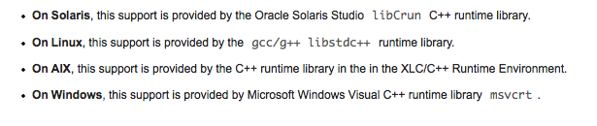
OpenMQ C API
Message Queue C runtime library is a multi-threaded library
requires C++ runtime library support

Slide 87
Compiling Programs
Compile & Link on Linux
g++ -DLINUX -D_REENTRANT -I header_path -o Sample \\ -L runtime_path -lmqcrt Sample.c
header path should link to MQ_HOME/includes
runtime path should link to MQ_HOME/lib

Slide 88
Compiling Programs
Compile & Link on Windows
cl /c /MD -DWIN32 -I%IMQ_HOME%\include Sample.c
link Sample.obj /NODEFAULTLIB msvcrt.lib \\ /LIBPATH:%IMQ_HOME%\lib mqcrt.lib

Slide 89
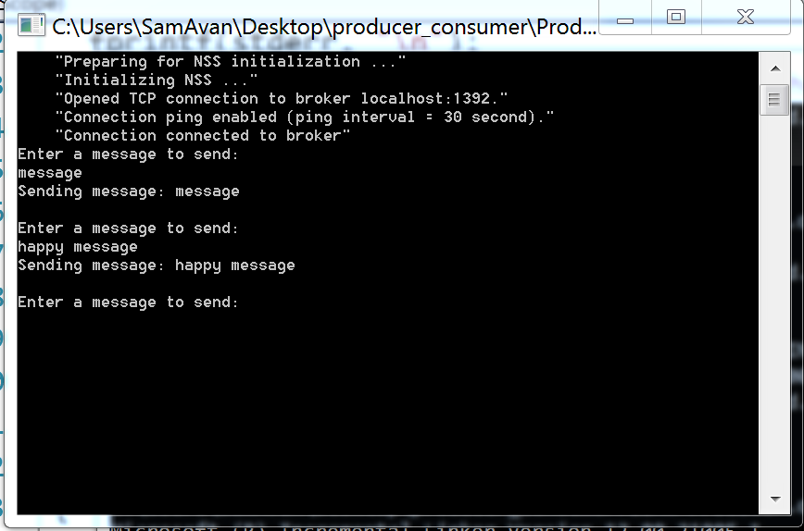
Output

Slide 90
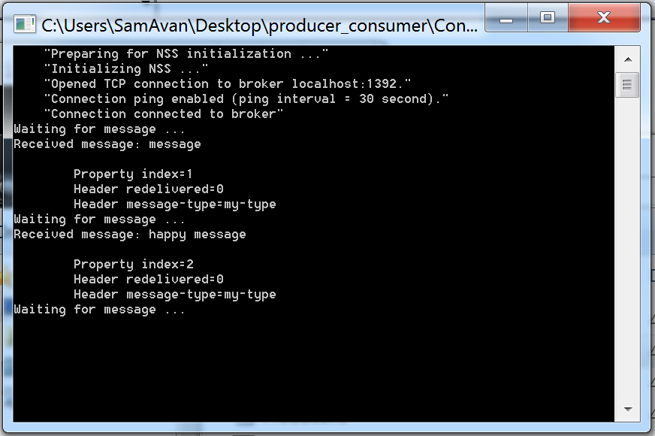
Output

